Slide 1

Internship Management System — Backend API
Centralized backend to manage internship programs end-to-end: company onboarding, student applications, interview orchestration, and reporting. Designed for reliability and developer-first integration.
Purpose
Tech Stack
Replace spreadsheets and scattered emails with a single source of truth for internship coordination across university teams and hiring partners.
Node.js, Express, MongoDB, Mongoose — tested with Postman; DB inspected via MongoDB Compass.
Current Health
Server: running on port 5000. Database: connected. Core collections active: companies, applications, interviews.

Slide 2


Company Module — Manage Hiring Partners
Companies are the hiring partners and primary anchor for applications. CRUD exposed as REST endpoints; persisted in the companies collection with schema fields: _id, name, industry, location, website.
Key Endpoints
POST /api/company/create — create a new hiring company (example: Dialog Axiata, Telecom, Colombo)
GET /api/company/getallcompanies — fetch all partners (returns WSO2, Dialog...)
PUT /api/company/update/:id — update company (e.g., location change to Kandy)
DELETE /api/company/delete/:id — remove partner from system
Use MongoDB Compass to validate documents and indexes in the companies collection.

Slide 3


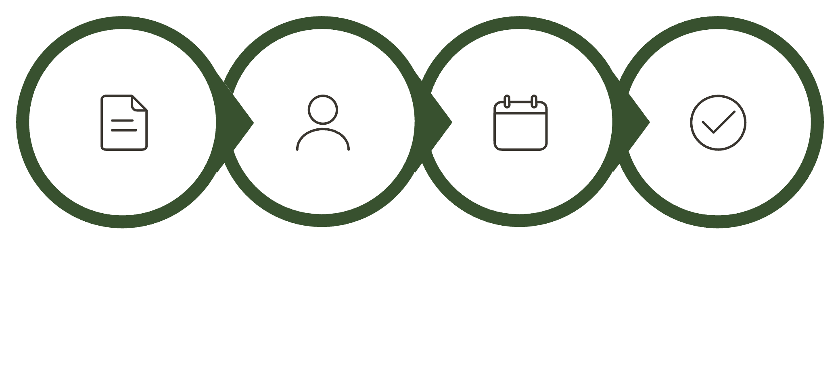
Application & Interview Modules — Student Journey
Track the full lifecycle from student application through interview and final outcome. Application records reference company documents so views populate partner metadata automatically.
Application Management
Interview Management
POST /api/application/create — students apply (example: Software Engineering Intern @ WSO2). GET /api/application/getallapplications — populated with company details. PUT /api/application/update/:id — status transitions (Applied → Interview). DELETE /api/application/delete/:id — withdraw.
interviews collection stores date, interviewer, feedback, result (Selected / Rejected / Waiting). Schema ready; scheduling and outcome updates plug directly into application status workflow.
Apply
Interview
Schedule
Finalize
Workflow: Student applies → Application status advances → Interview scheduled → Interview feedback recorded → Final outcome set. This keeps audit trails and enables reporting.

Slide 4


API Examples, Validation & Security
Practical examples and verification steps for backend engineers and integrators — concise guidance for testing, validation, and safe deployment.
Example Requests
Validation & Security
Create Application: POST /api/application/create — payload: studentId, companyId, position, resumeLink
Update Status: PUT /api/application/update/:id — payload: { status: "Interview", notes: "Called — scheduled" }
Company Create: POST /api/company/create — payload: { name, industry, location, website }
Validate inputs with Mongoose schemas and request middleware
Use environment variables for DB URI, server port, and API keys
Postman collections document request/response examples; include error cases
Ensure environment variables are never checked into source control. Rotate keys after sharing Postman exports.

Slide 5


Summary & Roadmap
Solid foundation in place: full CRUD for companies and applications, interviews collection established, server and DB running, and Postman-based test coverage. Next steps focus on polish, automation, and integrations.
1
2
Now
Near-Term
Production-quality CRUD, DB connected, Postman docs completed.
Implement interview scheduling automation, email notifications, and role-based access control.
3
4
Next
Action Items
Integrate analytics, exportable reports, and webhooks for partner integrations.
Harden validation & error handling
Add CI tests for endpoints (unit + integration)
Design API versioning and migration plan
Business value: a single authoritative backend that replaces manual coordination—faster placements, clearer audit trails, and scalable partner management.

